Slide 1
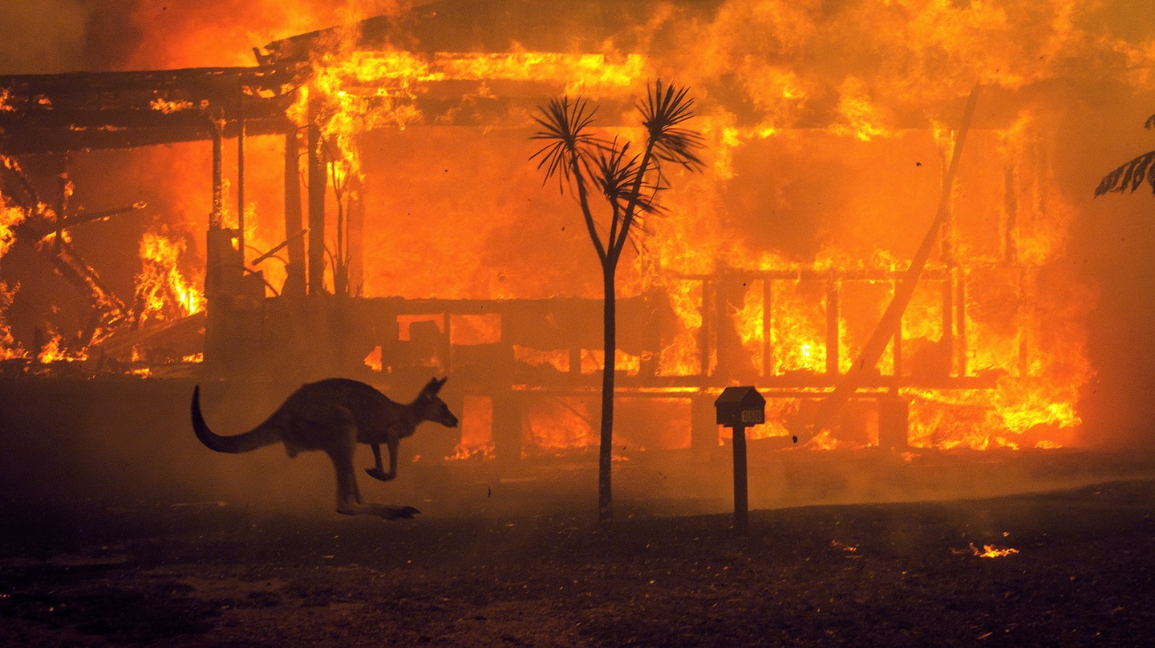
Real or Not? NLP with Disaster Tweets
Emilien NORY

Slide 2
Real or Not?
What files do I need?
You'll need train.csv and test.csv.
What should I expect the data format to be?
Each sample in the train and test set has the following information:
The text of a tweet
A keyword from that tweet (although this may be blank!) The location the tweet was sent from (may also be blank)
What am I predicting?
You are predicting whether a given tweet is about a real disaster or not. If so, predict a 1. If not, predict a 0.
Files
train.csv - the training set
test.csv - the test set
Columns
id - a unique identifier for each tweet
text - the text of the tweet
location - the location the tweet was sent from (may be blank)
keyword - a particular keyword from the tweet (may be blank)
target - in train.csv only, this denotes whether a tweet is about a real disaster (1) or not (0)

Slide 3
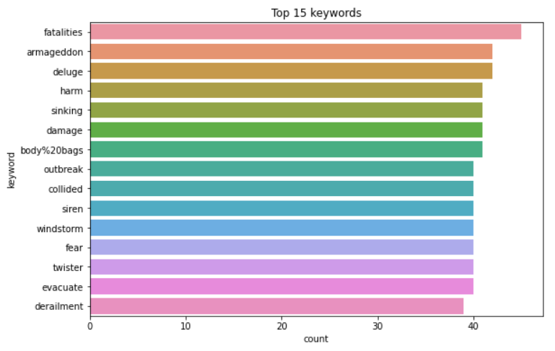
NLP with Disaster Tweets
There are 57% of tweets that are not related to a disaster.

Slide 4
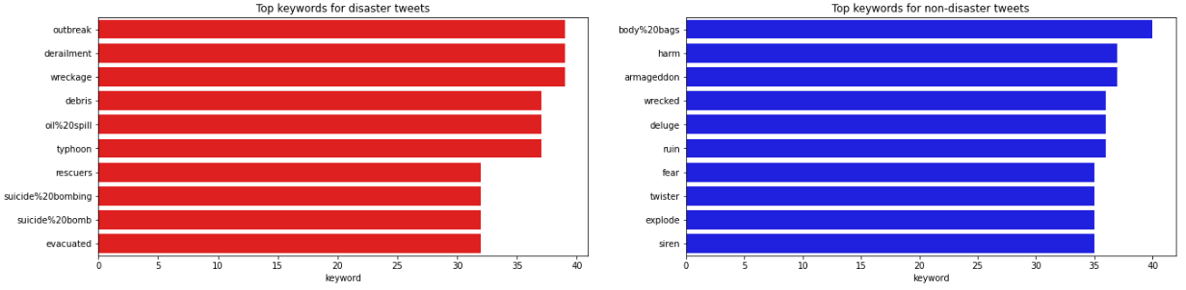
Top keyword

Slide 5
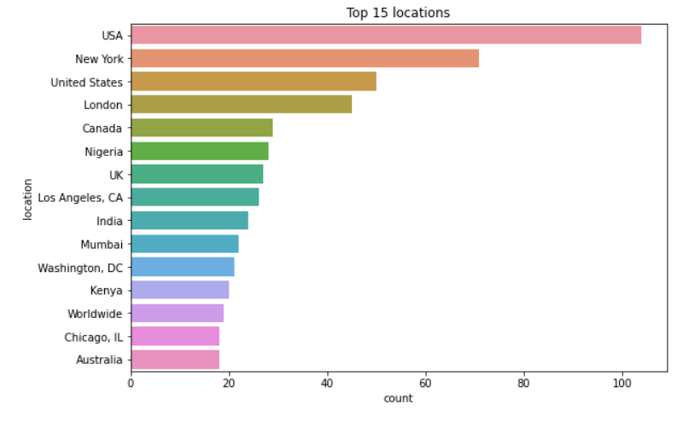
NLP with Disaster Tweets

Slide 6
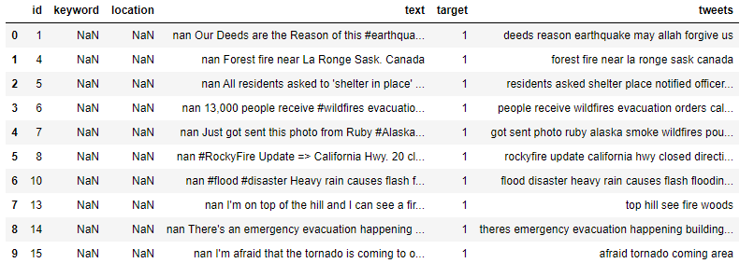
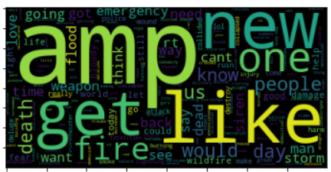
The most important words in tweeters datasets and preprocessing.

Slide 7
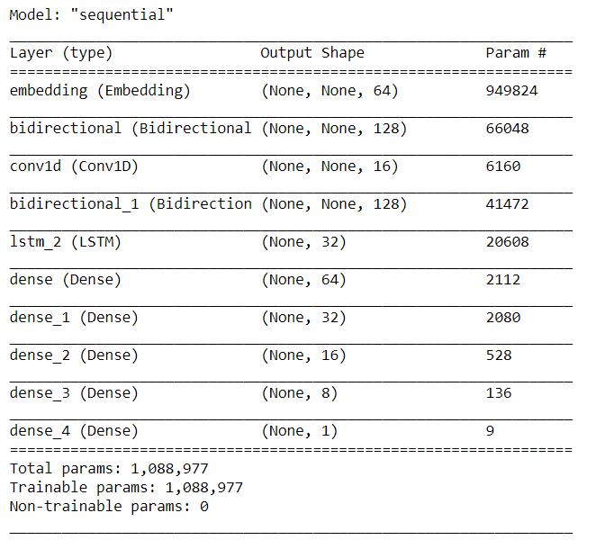
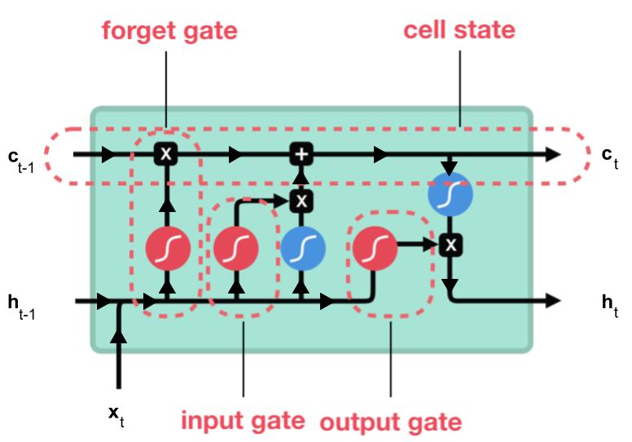
Modeling Architecture

Slide 8
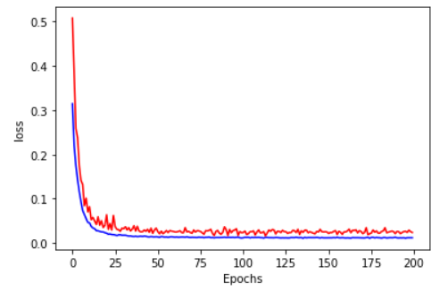
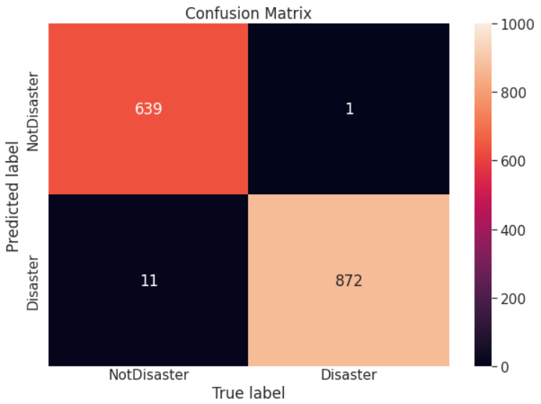
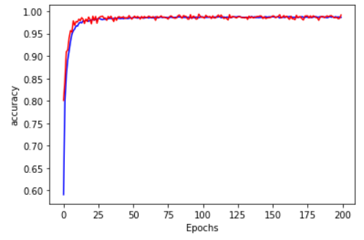
Result
We get a good result with 99.2% good predictions and a F1 score of 99%

